Slide 1

Analysis of Data Scientist job postings
ECE 143: Final Project Presentation of Group 10
Ria Aggarwal
Esther Grossman
Sahana Srikanth
Shengzhe Zhang

Slide 2

Motivation
Make sure the Job is the Right Fit
Get the Inside Scoop
Check out the Company Culture
Interviewing works both ways

Slide 3










Methodology
Data Collection
Data Processing
Data Visualisation

Slide 4
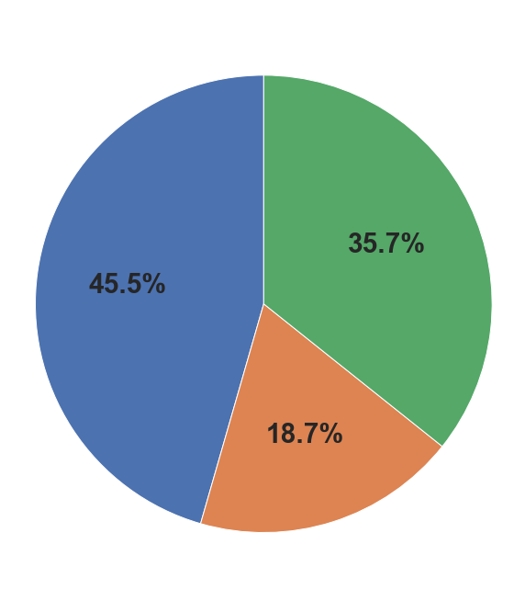
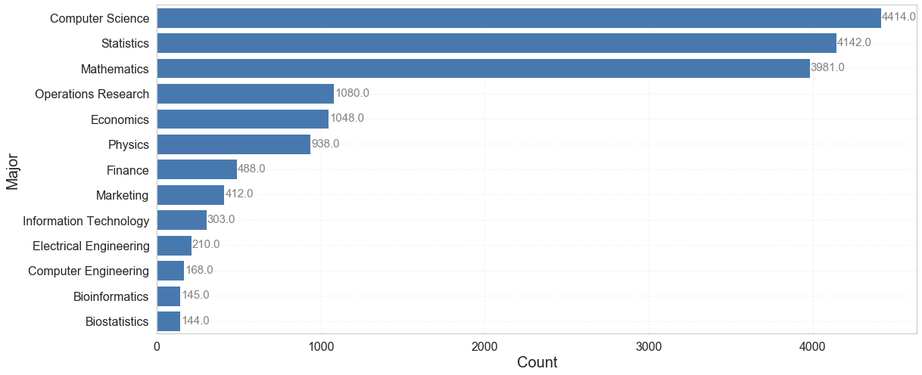
Who is getting hired?
Master’s
Phd
Bachelor’s
Notes:
What are the desired academic profiles of data scientists?
After analyzing 10,000 job postings, we found
Computer science, statistics and mathematics are the most sought after majors for employers.
Nevertheless, all area of STEM, as well as finance and marketing, are desired by employers.
In the upper right hand corner here, this pie chart shows almost half of job postings are searching for PhD applicants. Having masters leaves a large portion of the market open to you as well.

Slide 5
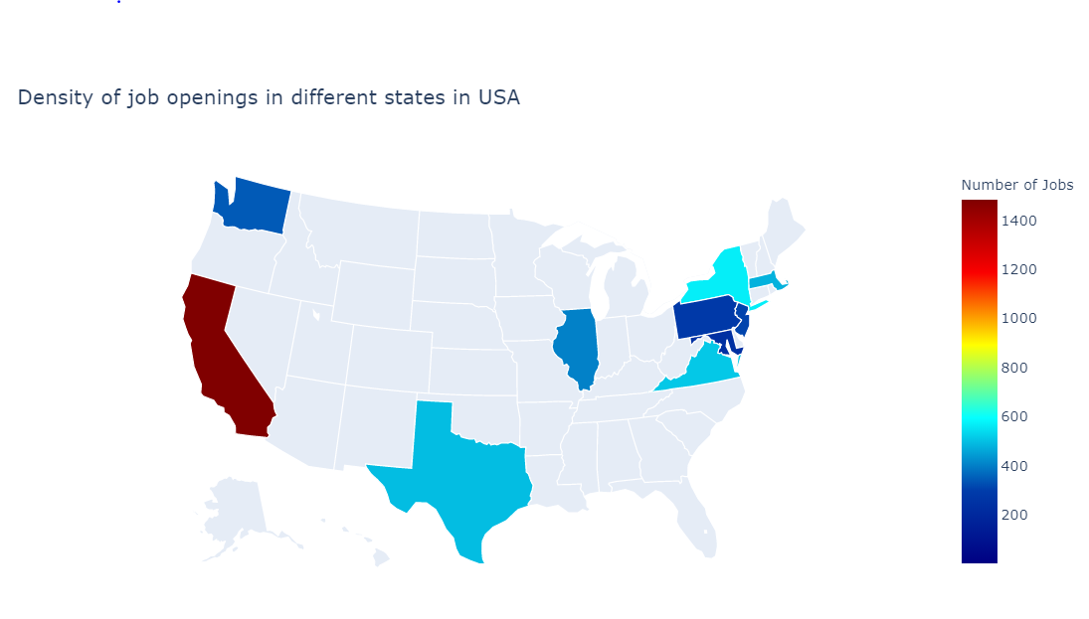
Know where to apply….
WA
WA
NY
MA
PA
NY
CA
IL
PA
IL
VA
CA
VA
TX
TX
Notes:
When you are deciding where you want to live after graduation, assess the job market for your field in that particular area.
This map of the United States shows where the 10,000 jobs we analyzed were located. The highest concentration is in California, followed by the New York and the northeast, Texas, and Washington. This makes sense becasue of large tech hubs light Wall street and silicon valley.

Slide 6
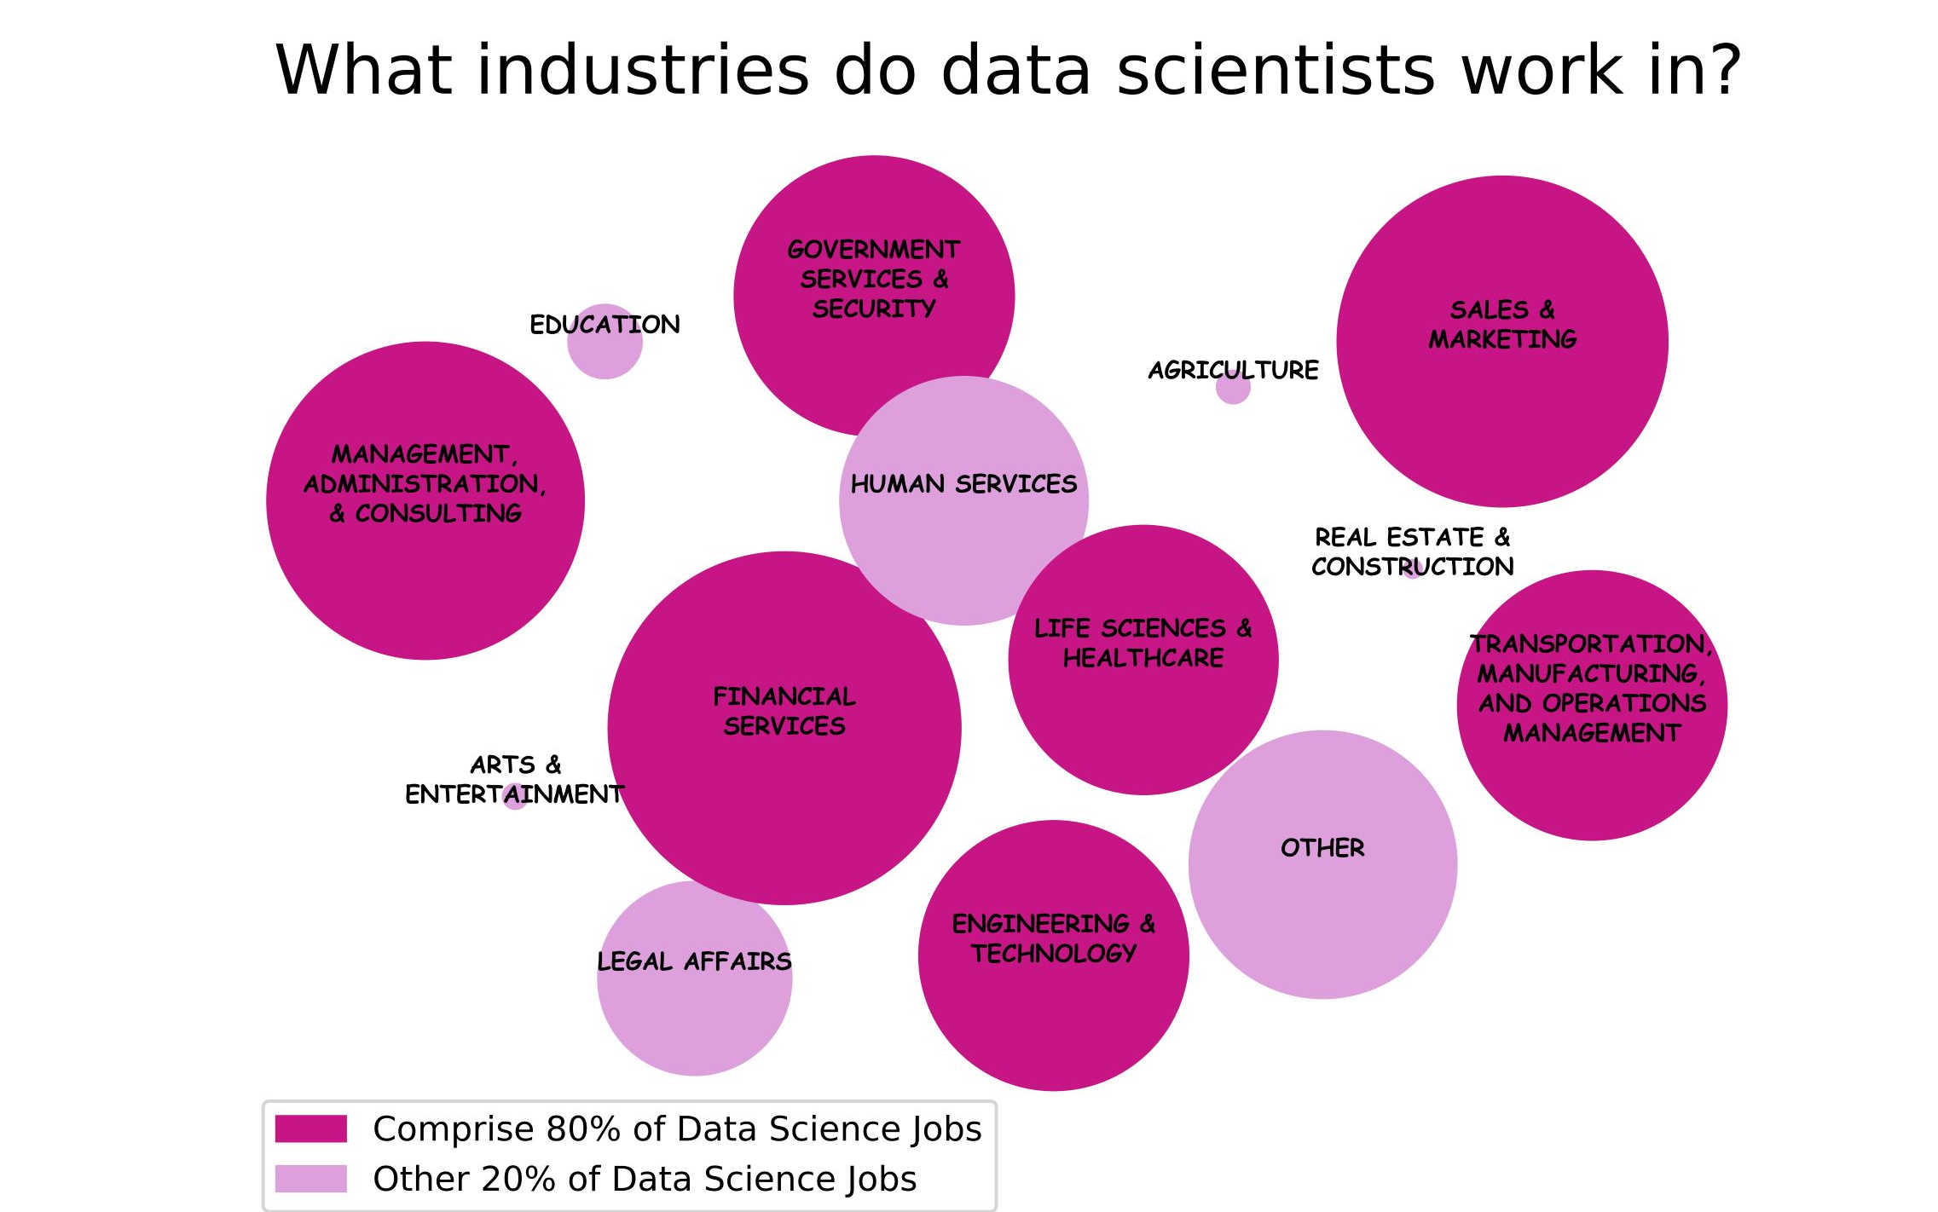
Notes:
-As data scientists, we can work in a variety of fields. Knowing what fields hire the most data scientists allows us to think about what industry we want to work in and perhaps what types of supplementary classes we want to take to increase our job prospects.
-The dark circles here indicate industries that make up 80% of the data science marketplace
-Here, the industries offering the most positions are shown as the largest bubbles. The top 3 sectors hiring are financial services, sales and marketing, and administration, consulting, and management.

Slide 7
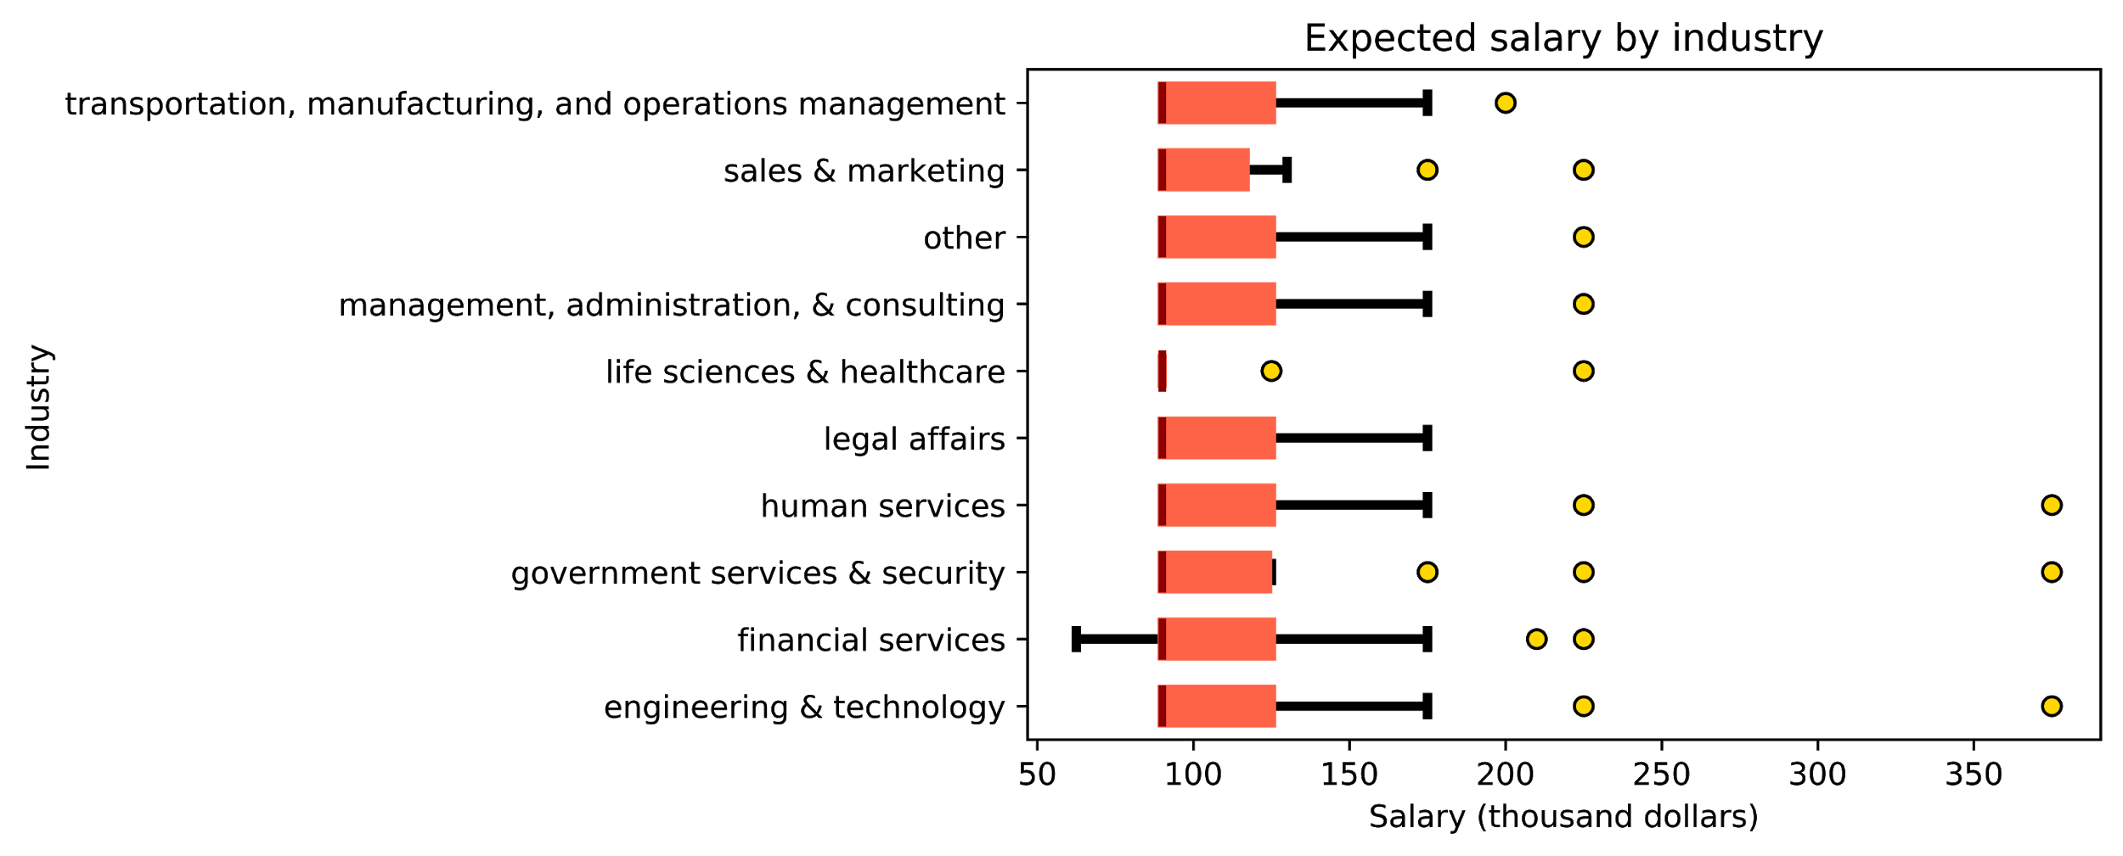
How much can you earn?
The industry standard is $90k - $125k
Notes:
How much can you earn as a data scientist?
Here is a chart of reported salary offerings by industry. You will notice, perhaps surprisingly, no industries offers much more than another.
Depicted in yellow on this box and whisker plt are outlier salary offerings. As you can see, there are only one or two high rollers in each industry being offered greater than 200-300k. A majority of the posted salaries are between 90 and 125k.
I think it is worth noting that less than 5% of the job descriptions we analyzed reported any salary data. Therefore, the onus is on us to know the industry standard for data scientists when going into an interview. This will help with negotiation and making sure you get the offer you deserve. We can infer from the median of our dataset here that the industry standard is about 90k.

Slide 8


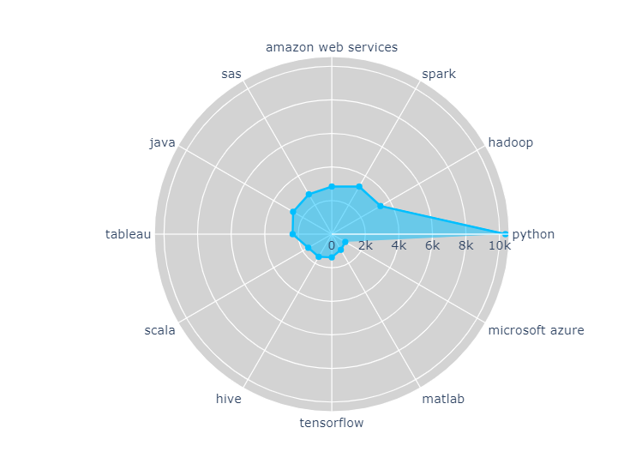




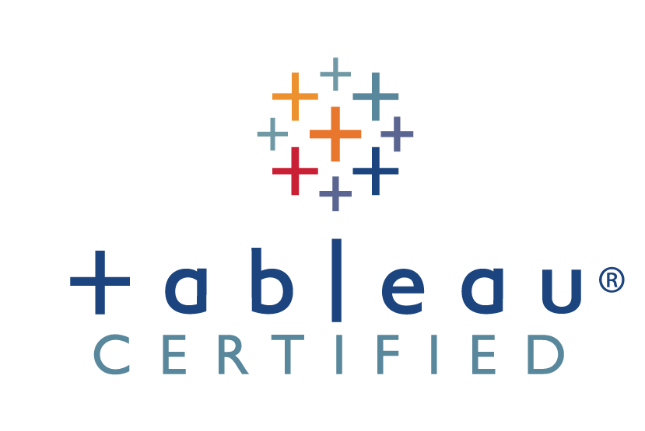





Know your tools...
Notes:
Now that you know how the job market is its time to see how to get a job
1.We have a spider chart here showing the major tools the company requires you to have knowlegde of.
2. No surprises , python is one of the most sought after tools by the industries , being equipped with powerful statistical and numerical libraries like pandas and numpy and advanced deep learning libraries like ,pybrain it is a must have tool one must possess.
3.This class has helped us get a good grasp on python and i would now like to talk about other tools that could help advance your career as a data scientist.
Statistical tools like SAS, data visualisation tools like Tableu , big data processing tools like hadoop , spark can all give you the necessary skillset to work as a Data Scientist.

Slide 9
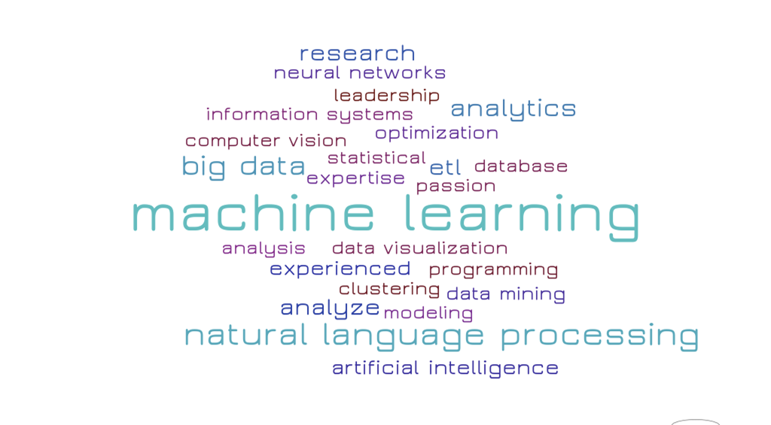
Make your resume stand out....
Notes:
Moving on to one of the integral part of every job search , how to make your resume stand out?
We have compiled a list of keywords that almost every company expects you to have on your resume.
We can see that analytics and machine learning are at the heart of data scientist jobs. Gleaning insights from data is a primary function of data science. Machine learning is all about creating systems to predict performance and it is very in demand.
NLP is important because it helps resolve ambiguity in language and adds useful numeric structure to the data for many downstream applications, such as speech recognition or text analytics.

Slide 10

Know what courses to take….
Python Programming:
ECE 143, DSC 2O, DSC 30, COGS 18
Big Data and Scalable Learning:
ECE 277, ECE 227
DSC 102, DSC 291
Machine Learning:
ECE 174, ECE 175, ECE 228, ECE 271, ECE 273, ECE 275, ECE 285, ECE 286
CSE 150, CSE 151A, CSE 250, CSE 254, CSE 255, CSE 291
COGS 108, COGS 118, COGS 181, COGS 185, COGS 188
Natural Language Processing:
CSE 156, CSE 256/LING 256
Computer Vision:
CSE 152, CSE 252, CSE 253, COGS 225, ECE 285, ECE 253, ECE 256
Database:
DSC 100, DSC 104, CSE 132, CSE 135
* Blue highlighted courses will be offered next quarter
Notes:
Now that we know what skills we need and what keywords to include to catch the eye of the employer , all we need to do is utilise the school’s resources and take the appropriate courses that would help you cultivate the skills mentioned before.

Slide 11

What have we learnt….
Higher the degree- higher the demand for you
Target the right locations.
Know the industry standard.
Better tools - better offers in hand.
Let your resume speak for you.
Right courses lead to dream jobs.
Notes:
If you want to pursue higher degree , its not a bad option to consider
You are already at the right location no place lile home
Know your industry standard to negotiate and get the salary you deserve\

Slide 12

Remember to stand out….

Slide 13
THANK YOU!

